Slide 1
Introduction to Cache
Z Gu
Acknowledgement: some slides are taken from CS61C course material at UC Berkeley

Slide 2
Agenda
Memory Hierarchy
Direct Mapped Caches
Cache Performance
Set Associative Caches
Multiprocessor Cache Consistency

Slide 3
Storage in a Computer
Processor
holds data in register file (~100 Bytes)
Registers accessed on sub-nanosecond timescale
Memory (we’ll call “main memory”)
More capacity than registers (~Gbytes)
Access time ~50-100 ns
Hundreds of clock cycles per memory access?!

Slide 4
Historical Perspective
1989 first Intel CPU with cache on chip
1998 Pentium III has two cache levels on chip
1000
µProc
60%/yr.
CPU
100
Processor-Memory
Performance Gap: (grows 50% / year)
Performance
10
DRAM
7%/yr.
DRAM
1
1989
1980
1990
1981
1982
1983
1984
1985
1986
1987
1988
1991
1992
1993
1994
1995
1996
1997
1998
1999
2000
Notes:
Y-axis is performance
X-axis is time
Latency
Cliché:
Not e that x86 didn’t have cache on chip until 1989

Slide 5
Library Analogy
Writing a report on a specific topic.
While at library, check out books and keep them on desk.
If need more, check them out and bring to desk.
But don’t return earlier books since might need them
Limited space on desk; Which books to keep?
You hope this collection of ~10 books on desk enough to write report, despite 10 being only 0.00001% of books in the library

Slide 6
Principle of Locality
Principle of Locality: Programs access small portion of address space at any instant of time
Notes:
What program structures lead to temporal and spatial locality in code?
Loops
In data?

Slide 7
Locality
Temporal Locality (locality in time)
Go back to same book on desktop multiple times
If a memory location is referenced then it will tend to be referenced again soon
Spatial Locality (locality in space)
When go to book shelf, pick up multiple books on the same topic since library stores related books together
If a memory location is referenced, the locations with nearby addresses will tend to be referenced soon
Notes:
How does the memory hierarchy work? Well it is rather simple, at least in principle.
In order to take advantage of the temporal locality, that is the locality in time, the memory hierarchy will keep those more recently accessed data items closer to the processor because chances are (points to the principle), the processor will access them again soon.
In order to take advantage of the spatial locality, not ONLY do we move the item that has just been accessed to the upper level, but we ALSO move the data items that are adjacent to it.
+1 = 15 min. (X:55)

Slide 8
Does Locality Exist?
Instruction accesses spend a lot of time on the same page (since accesses mostly sequential, loop body tends to be small)
Stack accesses have definite locality of reference
Data accesses have less locality, but still some, depending on application…

Slide 9
How does hardware exploit principle of locality?
Offer a hierarchy of memories where
closest to processor is fastest (and most expensive per bit so smallest)
furthest from processor is largest (and least expensive per bit so slowest)
Goal is to create illusion of memory almost as fast as fastest memory and almost as large as biggest memory of the hierarchy

Slide 10
Motivation for Mem Hierarchy
Wanted: size of the largest memory available, speed of the fastest memory available
Approach: Memory Hierarchy
Successively lower levels contain “most used” data from next higher level
Exploits temporal & spatial locality

Slide 11
Memory Hierarchy
Processor
Higher
Increasing distance from processor, decreasing speed
Levels in memory hierarchy
Level 1
Level 2
Level 3
Lower
. . .
Level n
Size of memory at each level
As we move to deeper levels the latency goes up and price per bit goes down.

Slide 12
Cache
Processor and memory speed mismatch leads us to add a new level: a cache
Implemented with same integrated circuit processing technology as processor, integrated on-chip: faster but more expensive than DRAM memory
Modern processors have separate caches for instructions and data, as well as several levels of caches implemented in different sizes
As a pun, often use $ (“cash”) to abbreviate cache, e.g. D$ = Data Cache, I$ = Instruction Cache
Cache is a copy of a subset of main memory

Slide 13
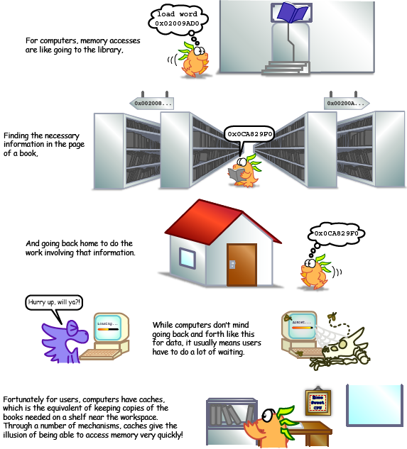
Illustration from http://csillustrated.berkeley.edu/PDFs/cache-basics.pdf

Slide 14
Memory Hierarchy Technologies
Caches use SRAM (Static RAM) for speed and technology compatibility
Fast (typical access times of 0.5 to 2.5 ns)
Low density (6 transistor cells), higher power, expensive ($2000 to $4000 per GB in 2011)
Static: content will last as long as power is on
Main memory uses DRAM (Dynamic RAM) for size (density)
Slower (typical access times of 50 to 70 ns)
High density (1 transistor cells), lower power, cheaper ($20 to $40 per GB in 2011)
Dynamic: needs to be “refreshed” regularly (~ every 8 ms)
Consumes 1% to 2% of the active cycles of the DRAM
Notes:
Size comparison: DRAM/SRAM is 4 to 8 times
Cost/cycle time comparison SRAM/DRAM is 8 to 16 times
http://parts.digikey.com/1/parts/1211303-ic-sram-1mbit-10ns-32soj-cy7c109d-10vxi.html
Quantity discount 10ns 1MBit SRAM $2.24, $17/Mbyte, $1700/100 Mbyte, $17000/GByte
http://www.frys.com/template/harddrives
DRAM: 4GB @ $70 or $17.50 per GB
24GB@$800 = $33/Gbyte
http://www.frys.com/category/Outpost/Hard+Drives+&+Memory/Memory/Notebook+Memory/Apple+-+Mac++Memory/
DDR2 1GB @ $25 per
DDR3 1 GB @ $37.5 per
FLASH Media
Approx. $2 per Gbyte

Slide 15
Characteristics of the Memory Hierarchy
Block – Unit of transfer between memory and cache
Processor
Inclusive– what is in L1$ is a subset of what is in L2$ is a subset of what is in MM that is a subset of is in SM
4-8 bytes (word)
Increasing distance from the processor in access time
L1$
8-32 bytes (block)
L2$
16-128 bytes (block)
Main Memory
4,096+ bytes (page)
Secondary Memory
(Relative) size of the memory at each level
Notes:
Because the upper level is smaller and built using faster memory parts, its hit time will be much smaller than the time to access the next level in the hierarchy (which is the major component of the miss penalty).

Slide 16
Typical Memory Hierarchy
On-Chip Components
Control
Instr
Cache
Second
Level
Cache
(SRAM)
Secondary
Memory
(Disk
Or Flash)
Main
Memory
(DRAM)
Datapath
RegFile
Data
Cache
Speed (cycles): ½’s 1’s 10’s 100’s 1,000,000’s
Size (bytes): 100’s 10K’s M’s G’s T’s
Cost/bit: highest lowest
Principle of locality + memory hierarchy presents programmer with ≈ as much memory as is available in the cheapest technology at the ≈ speed offered by the fastest technology
Notes:
Instead, the memory system of a modern computer consists of a series of black boxes ranging from the fastest to the slowest.
Besides variation in speed, these boxes also varies in size (smallest to biggest) and cost.
What makes this kind of arrangement work is one of the most important principle in computer design. The principle of locality. The principle of locality states that programs access a relatively small portion of the address space at any instant of time.
The design goal is to present the user with as much memory as is available in the cheapest technology (points to the disk).
While by taking advantage of the principle of locality, we like to provide the user an average access speed that is very close to the speed that is offered by the fastest technology.
(We will go over this slide in detail in the next lectures on caches).

Slide 17
How is the Hierarchy Managed?
registers ↔ memory
By compiler (or assembly level programmer)
cache ↔ main memory
By the cache controller hardware
main memory ↔ disks (secondary storage)
By the operating system (virtual memory)
Virtual to physical address mapping assisted by the hardware (TLB)
By the programmer (files)

Slide 18
Cache Management
Cache managed automatically by hardware.
Operations available in hardware are limited, scheme needs to be relatively simple.
Where in the cache do we put a block of data from memory?
How do we find it when we need it?
What is the overall organization of blocks we impose on our cache?

Slide 19
Direct Mapped Caches
Each memory block is mapped to exactly one block in the cache
A “cache block” is also called a “cache line”
Only need to check this single location to see if block is in cache.
Cache is smaller than memory
Multiple blocks in memory map to a single block in the cache!
Need some way of determining the identity of the block.

Slide 20
Direct Mapped Cache
Block Address
Block
offset
Tag
Index
Set Select
Data Select
Index Used to Lookup Candidates in Cache
Index identifies the set; which address in the cache is the block stored?
Tag used to identify actual copy
If no candidates match, then declare cache miss; since multiple memory addresses can map to the same cache address, which block in memory did the block come from?
Block is minimum quantum of caching
Offset field used to select data within block; which byte within a block is referenced?
Address mapping:
cache index = (memory block address (Tag&Index)) modulo (# of blocks in the cache)
Notes:
n-bit Index means cache has 2^{n} blocks
n-bit Offset means a block is 2^{n} bytes
Index = (block address) modulo (# of blocks in the cache (4))
Memory address format:
Upper bits of memory address (Tag) determine which block in memory the block came from.
Middle bits of memory address (Index) determine which block in the cache the block is stored.
Lower bits of address (Offset) determine which byte within a block it refers to.
Many caching applications don’t have this field

Slide 21
Summary: Tag, Index, Offset
Tag
used to distinguish between multiple memory addresses that map to a given cache block index
Index
specifies the cache block index (which “row”/block of the cache we should look in)
I bits <=> 2^{I} blocks in cache
Offset
once we’ve found correct cache block index, specifies which byte within the block we want (which “column” in the cache)
O bits <=> 2^{O} bytes per block
Each block in memory maps to one block in the cache.
Index to determine which block
Tag to determine if it’s the right block
Offset to determine which byte within block
Notes:
the remaining bits after offset and index are determined; these are

Slide 22
Direct Mapped Cache Example
Main Memory - 6 bit addresses
0000xx
0001xx
0010xx
0011xx
0100xx
0101xx
0110xx
0111xx
1000xx
1001xx
1010xx
1011xx
1100xx
1101xx
1110xx
1111xx
Tag: upper 2 bits → 4 memory addresses mapped to the same cache block index
Index: middle 2 bits → 4 blocks in cache; Index defines which cache block index the mem address is mapped to, by modulo 4 arithmetic
Offset: lower 2 bits → 1 word (4 bytes) per block; Offset defines the byte within the cache block
Cache
Index
Valid
Tag
Data
00
01
10
11
1bit
2bits
4Bytes
Q: Is the mem block in cache?
Compare the cache tag to the high order 2 memory address bits (Tag) to tell if the memory block is in the cache
Index = (block address) modulo (# of blocks in the cache (4))
Notes:
For lecture
Valid bit indicates whether an entry contains valid information – if the bit is not set, there cannot be a match for this block

Slide 23
Quiz
What if we flip positions of Tag and Index? Have Index as higher-order bits, and Tag as lower-order bits?
Exercise: redraw the previous slide with this configuration
Bad idea: Neighboring blocks in memory are mapped to the same cache line, since they share the same Index value;
if memory blocks are accessed sequentially, then each new incoming cache block will immediately replace the previous block at the same cache line, causing cache thrashing → cannot exploit spatial locality.

Slide 24
Word vs. Byte
Most modern CPUs, e.g., MIPS, operate with words (4 bytes), since it is convenient for 32-bit arithmetic. Entire words will be transferred to and from the CPU. Hence the only possible byte offsets are multiples of 4.
When we use words as the unit of memory size, we leave out the last 2 bits of offset for byte addressing

Slide 25
Direct Mapped Cache Example
8-bit address space. Tag: 3 bits, Index: 2 bits, Offset: 3 bits
Index 2 bits → 2^2=4 cache blocks
Offset 3 bits → 8 Bytes/block,
Cache size = 4 blocks * 8 Bytes/block = 32 Bytes (8 words)
Tag 3 bits → 2^3=8 memory addresses mapped to the same cache index
Byte Offset
V | Tag | 000 | 001 | 010 | 011 | 100 | 101 | 110 | 111
00
1 W O R D
1 W O R D
Index
01
10
11
Notes:
2 words (

Slide 26
Direct Mapped Cache Example 2
32 bit address space. Tag: 20 bits; Index: 8 bits; Offset: 4 bits
2^8=256 cache blocks, 2^4=16 Bytes/block
Cache size = 256 blocks * 16 Bytes/block = 4K Bytes (1K words)
2^20=1 million memory addresses mapped to each cache index
Byte offset
Hit
31 30 . . . 13 12 11 . . . 4 3 2 1 0
Data
Tag
20
8
Block offset
Index
Index
Valid
Tag
Data (words)
0
1
2
.
.
.
253
254
255
20
and
32
Notes:
to take advantage for spatial locality want a cache block that is larger than word word in size.

Slide 27
Caching Terminology
When accessing a memory address, 2 things can happen:
cache hit: cache block is valid and refers to the proper memory address, so read desired word from cache (fast)
cache miss: cache block is invalid, or refers to the wrong memory address, so read from memory (slow)

Slide 28
Direct Mapped Cache Example
Consider the 6-bit memory address example; sequence of memory address accesses (Byte offset bits are ignored, so only 4-bit word addresses: Tag 2bits; Index 2bits)
0 1 2 3 4 3 4 15
Start with an empty cache - all blocks initially marked as not valid
0000 0001 0010 0011 0100 0011 0100 1111
0
miss
1
miss
2
miss
3
miss
00 Mem(0)
00 Mem(0)
00 Mem(0)
00 Mem(1)
00 Mem(0)
00 Mem(1)
00 Mem(2)
00 Mem(1)
00 Mem(2)
00 Mem(3)
Time
4
miss
3
hit
4
hit
15
miss
01
4
00 Mem(0)
00 Mem(1)
00 Mem(2)
00 Mem(3)
01 Mem(4)
00 Mem(1)
00 Mem(2)
00 Mem(3)
01 Mem(4)
00 Mem(1)
00 Mem(2)
00 Mem(3)
01 Mem(4)
00 Mem(1)
00 Mem(2)
00 Mem(3)
11
15
Time
8 requests, 6 misses
Notes:
For lecture
Reference string is word addresses (or block number since we are using one word blocks) – i.e., the low order two bits used to selected the byte in the 32-bit word are ignored

Slide 29
Taking Advantage of Spatial Locality
Each cache block holds 2 words; so Tag 2bits; Index 1bit; Offset 1bit (for 1 of 2 words in block)
0 1 2 3 4 3 4 15
Start with an empty cache - all blocks initially marked as not valid
0000 0001 0010 0011 0100 0011 0100 1111
0
miss
1
hit
2
miss
00 Mem(1) Mem(0)
00 Mem(1) Mem(0)
00 Mem(1) Mem(0)
00 Mem(3) Mem(2)
3
hit
4
miss
3
hit
01
5
4
00 Mem(1) Mem(0)
00 Mem(1) Mem(0)
01 Mem(5) Mem(4)
00 Mem(3) Mem(2)
00 Mem(3) Mem(2)
00 Mem(3) Mem(2)
4
hit
15
miss
01 Mem(5) Mem(4)
01 Mem(5) Mem(4)
11
00 Mem(3) Mem(2)
00 Mem(3) Mem(2)
15
14
8 requests, 4 misses
Notes:
For lecture
Show the 4-bit address mapping – 2-bits of tag, 1-bit of set address (index), 1-bit of word-in-block select

Slide 30
Miss Rate vs Block Size vs Cache Size
Miss rate goes up if the block size becomes a significant fraction of the cache size because the number of blocks that can be held in the same size cache is smaller (increasing capacity misses)
A more serious problem is that the miss penalty goes up, since it is the time to fetch the block from the next lower level of the hierarchy and load it into the cache.
Notes:
Increasing the block size usually decreases the miss rate.
A more serious problem is that the miss penalty goes up since it is primarily determined by the time to fetch the block from the next lower level of the hierarchy and load it into the cache.

Slide 31
Average Memory Access Time (AMAT)
Average Memory Access Time (AMAT) is the average to access memory considering both hits and misses
AMAT = Hit Time + Miss rate x Miss penalty
Q:Why is it not “(1-Miss rate) x Hit Time + Miss rate * Miss Time”?
A: Same, since Miss Time=Hit Time + Miss penalty
What is the AMAT for a processor with a 200 psec clock, a miss penalty of 50 clock cycles, a miss rate of 0.02 misses per instruction and a cache access time of 1 clock cycle?
1 + 0.02 x 50 = 2 clock cycles
Or 2 x 200 = 400 psecs
Notes:
AMAT = 1 + 0.02x50 = 2

Slide 32
Potential impact of much larger cache on AMAT?
1) Lower Miss rate
2) Longer Access time (Hit time): smaller is faster
Increase in hit time will likely add another stage to the CPU pipeline
At some point, increase in hit time for a larger cache may overshadow the improvement in hit rate, yielding a overall decrease in performance

Slide 33
Measuring Cache Performance – Effect on CPI
Assuming cache hit costs are included as part of the normal CPU execution cycle, then
CPU time = IC (Instruction Count) × CPI (Cycles per Instruction)× CC (Clock Cycle)
= IC × (CPI_{ideal} + Average Memory-stall cycles) × CC
CPI_{stall}
A simple model for Memory-stall cycles
Memory-stall cycles = accesses/instruction × miss rate × miss penalty
Notes:
Reasonable write buffer depth (e.g., four or more words) and a memory capable of accepting writes at a rate that significantly exceeds the average write frequency means write buffer stalls are small

Slide 34
Impacts of Cache Performance
Relative $ penalty increases as processor performance improves (faster clock rate and/or lower CPI)
Memory speed unlikely to improve as fast as processor cycle time. When calculating CPI_{stall}, cache miss penalty is measured in processor clock cycles needed to handle a miss
Lower the CPI_{ideal}, more pronounced impact of stalls
Processor with a CPI_{ideal} of 2, a 100 cycle miss penalty, 36% load/store instr’s, and 2% I$ and 4% D$ miss rates
Memory-stall cycles = 2% × 100 + 36% × 4% × 100 = 3.44
So CPI_{stalls} = 2 + 3.44 = 5.44
More than twice CPI_{ideal}!
Notes:
What if the CPI_{ideal} is reduced to 1?
What if the D$ miss rate went up by 1%?
For ideal CPI = 1, then CPIstall = 4.44 and the amount of execution time spent on memory stalls would have risen from 3.44/5.44 = 63% to 3.44/4.44 = 77%
For miss penalty of 200, memory stall cycles = 2% 200 + 36% x 4% x 200 = 6.88 so that CPIstall = 8.88
This assumes that hit time (so hit time is 1 cycle) is not a factor in determining cache performance. A larger cache would have a longer access time (if a lower miss rate), meaning either a slower clock cycle or more stages in the pipeline for memory access.

Slide 35
Handling Cache Misses (Single Word Blocks)
Read misses (I$ and D$)
Stall execution, fetch the block from the next level in the memory hierarchy, install it in the cache, send requested word to processor, and then let execution resume
Write misses (D$ only)
Write allocate: fetch the block from memory to cache before writing the word from processor to cache
or
No-write allocate: skip the cache write and just write the word to memory
Notes:
Let’s look at our 1KB direct mapped cache again.
Assume we do a 16-bit write to memory location 0x000000 and causes a cache miss in our 1KB direct mapped cache that has 32-byte block select.
After we write the cache tag into the cache and write the 16-bit data into Byte 0 and Byte 1, do we have to read the rest of the block (Byte 2, 3, ... Byte 31) from memory?
If we do read the rest of the block in, it is called write allocate. But the type of access we are going to do is likely to be another write.
So if even if we do read in the data, we may end up overwriting them anyway so it is a common practice to NOT read in the rest of the block on a write miss.
If you don’t bring in the rest of the block, or use the more technical term, Write Not Allocate, you better have some way to tell the processor the rest of the block is no longer valid.

Slide 36
Write-Allocate
Consider a direct-mapped cache with 2-word (8-byte) cache block size. Assume we do a 4-byte write to memory location 0x000000 and causes a cache miss. Do we have to load the entire block (Bytes 0-7) from memory to cache before we write the cache tag and the 4-byte data into Bytes 0-3?
If we do load the block before writing, it is called write allocate.
If not, it is called write-no-allocate
In this case, you need some way to tell the processor the rest of the block is no longer valid.
Otherwise, you may have half of the cache block (Bytes 0-3) referring to one memory block, and the other half (Bytes 4-7) referring to another memory block, both mapped to the same cache index!

Slide 37
Cache-Memory Consistency? (1/2)
Need to make sure cache and memory are consistent (know about all updates)
1) Write-Through Policy: write cache and write through the cache to memory
Every write eventually gets to memory
Too slow, so include Write Buffer to allow processor to continue once data in Buffer, Buffer updates memory in parallel to processor
2) Write-Back Policy: write only to cache and then write cache block back to memory when evict block from cache
Writes collected in cache, only single write to memory per block
Include bit to see if wrote to block or not, and then only write back if bit is set
Called “Dirty” bit (writing makes it “dirty”)
Typical combinations:
Write-back + write allocate,
Hoping for a subsequent writes (or reads) to the same location, which is now cached.
Write-through + no-write allocate.
Consecutive writes have no advantage, since they still need to be written directly to memory

Slide 38
Write-through vs. Write-back
WT:
PRO: read misses cannot result in writes
CON: Processor held up on writes unless writes buffered
WB:
PRO: repeated writes not sent to DRAM processor not held up on writes
CON: More complex Read miss may require write back of dirty block
Clean miss: the block being replaced is clean
Dirty miss: the block being replaced is dirty and needs to be written back to memory

Slide 39
Recall: Average Memory Access Time (AMAT)
Average Memory Access Time (AMAT) is the average to access memory considering both hits and misses
AMAT = Time for a hit + Miss rate x Miss penalty
How reduce Miss Penalty?
Notes:
AMAT = 1 + 0.02x50 = 2

Slide 40
Multiple Cache Levels
Main Memory
L2$
L1$
CPU
Mem
Access
.
.
.
Miss
Hit
Miss
Hit
Path of Data Back to CPU

Slide 41
Multiple Cache Levels
With advancing technology, have more room on die for bigger L1 caches and for second level cache – normally a unified L2 cache (i.e., it holds both instructions and data,) and in some cases even a unified L3 cache
New AMAT Calculation: AMAT = L1 Hit Time + L1 Miss Rate * L1 Miss Penalty L1 Miss Penalty = L2 Hit Time + L2 Miss Rate * L2 Miss Penalty and so forth (final miss penalty is Main Memory access time)
Notes:
Also reduces cache miss penalty

Slide 42
New AMAT Example
1 cycle L1 Hit Time, 2% L1 Miss Rate, 5 cycle L2 Hit Time, 5% L2 Miss Rate.
100 cycle Main Memory access time
No L2 Cache: AMAT = 1 + .02*100 = 3
With L2 Cache: AMAT = 1 + .02*(5 + .05*100) = 1.2!

Slide 43
Local vs. Global Miss Rates
Local miss rate – the fraction of references to one level of a cache that miss
Local Miss rate L2$ = $L2 Misses / L1$ Misses
Global miss rate – the fraction of references that miss out of all memory accesses in system.
L2$ local miss rate >> than the global miss rate
Global Miss rate = L2$ Misses / Total Accesses
= L2$ Misses / L1$ Misses x L1$ Misses / Total Accesses
= Local Miss rate L2$ x Local Miss rate L1$
AMAT Calculation used Local Miss Rate.

Slide 44
Design Considerations
Different design considerations for L1$ and L2$
L1$ focuses on fast access: minimize hit time to achieve shorter clock cycle, e.g., smaller $
L2$ (and L3$) focus on low miss rate: reduce penalty of long main memory access times: e.g., Larger $ with larger block sizes/higher levels of associativity
Miss penalty of L1$ is significantly reduced by presence of L2$, so can be smaller/faster even with higher miss rate
For the L2$, fast hit time is less important than low miss rate
L2$ hit time determines L1$’s miss penalty
L2$ local miss rate >> than the global miss rate
Notes:
Global miss rate – the fraction of references that miss in all levels of a multilevel cache. The global miss rate dictates how often we must access the main memory.
Local miss rate – the fraction of references to one level of a cache that miss

Slide 45
Sources of Cache Misses: The 3Cs
Compulsory (cold start or process migration, 1st reference):
First access to block impossible to avoid; small effect for long running programs
Solution: increase block size (increases miss penalty; very large blocks could increase miss rate)
Capacity:
Cache cannot contain all blocks accessed by the program
Solution: increase cache size (may increase access time)
Conflict (collision):
Multiple memory locations mapped to the same cache location
Solution 1: increase cache size
Solution 2: increase associativity (may increase access time)
Notes:
(Capacity miss) That is the cache misses are due to the fact that the cache is simply not large enough to contain all the blocks that are accessed by the program.
The solution to reduce the Capacity miss rate is simple: increase the cache size.
Here is a summary of other types of cache miss we talked about.
First is the Compulsory misses. These are the misses that we cannot avoid. They are caused when we first start the program.
Then we talked about the conflict misses. They are the misses that caused by multiple memory locations being mapped to the same cache location.
There are two solutions to reduce conflict misses. The first one is, once again, increase the cache size. The second one is to increase the associativity.
For example, say using a 2-way set associative cache instead of directed mapped cache.
But keep in mind that cache miss rate is only one part of the equation. You also have to worry about cache access time and miss penalty. Do NOT optimize miss rate alone.
Finally, there is another source of cache miss we will not cover today. Those are referred to as invalidation misses caused by another process, such as IO , update the main memory so you have to flush the cache to avoid inconsistency between memory and cache.
+2 = 43 min. (Y:23)

Slide 46
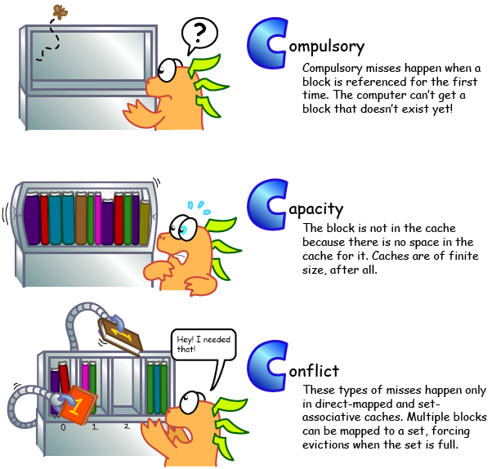
Illustration from http://csillustrated.berkeley.edu/PDFs/cache-misses.pdf

Slide 47
Reducing Cache Misses
Allow more flexible block placement in cache
Direct mapped $: memory block maps to exactly one cache block
Fully associative $: allow a memory block to be mapped to any cache block
Compromise: divide $ into sets, each of which consists of n addresses (“ways”) (n-way set associative) to place memory block
Cache set index=(block address) modulo (# sets in the cache)
A block can be placed in any of the n addresses (ways) of the cache set it belongs to.
Notes:
All of the tags of all of the elements of the set must be searched for a match.

Slide 48
Alternative Block Placement Schemes
Example: Block 12 in 5-bit (32-block) memory address space placed in 3-bit (8 block) cache address space.
32-Block Address Space:
Block
no.
1 1 1 1 1 1 1 1 1 1 2 2 2 2 2 2 2 2 2 2 3 3
0 1 2 3 4 5 6 7 8 9 0 1 2 3 4 5 6 7 8 9 0 1 2 3 4 5 6 7 8 9 0 1

Slide 49
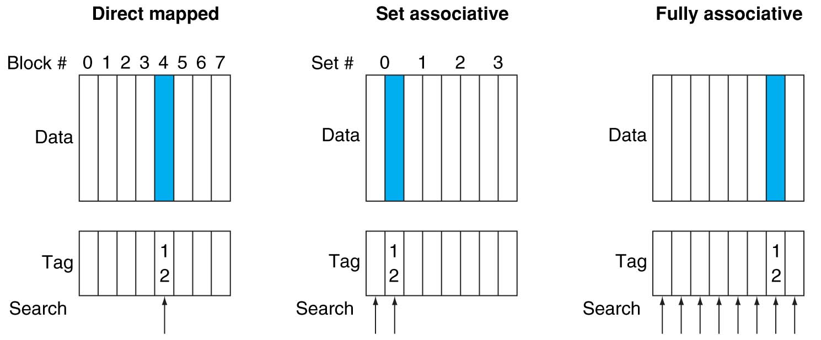
Alternative Block Placement Schemes
DM placement: mem block 12 in 8 block cache: only one cache block where mem block 12 can be found—(12 modulo 8) = 4
SA placement: four sets x 2-ways (8 cache blocks), memory block 12 in set (12 mod 4) = 0; either element of the set
FA placement: mem block 12 can appear in any cache block

Slide 50
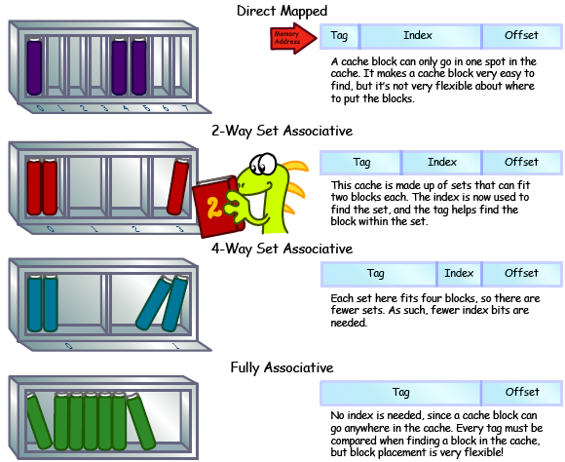
Illustration from http://csillustrated.berkeley.edu/PDFs/cache-types.pdf

Slide 51
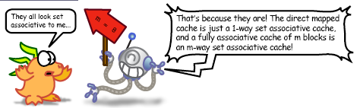

Slide 52
Example: 4-Word Direct-Mapped $Worst-Case Reference String
Consider the sequence of memory accesses
0(0000) 4(0100) 0 4 0 4 0 4
Start with an empty cache - all blocks initially marked as not valid
0
miss
01
4
miss
00
0
miss
01
4
miss
4
4
0
00 Mem(0)
00 Mem(0)
01 Mem(4)
00 Mem(0)
00
0
miss
0
01
4
miss
4
00
0
miss
0
01
4
miss
4
01 Mem(4)
00 Mem(0)
01 Mem(4)
00 Mem(0)
8 requests, 8 misses
Ping pong effect due to conflict misses - two memory locations that map into the same cache block
Notes:
For class handout

Slide 53
Recall: Direct Mapped Cache Example
Main Memory - 6 bit addresses
0000xx
0001xx
0010xx
0011xx
0100xx
0101xx
0110xx
0111xx
1000xx
1001xx
1010xx
1011xx
1100xx
1101xx
1110xx
1111xx
Tag: upper 2 bits → 4 memory addresses mapped to the same cache block index
Index: middle 2 bits → 4 blocks in cache; Index defines which cache block index the mem address is mapped to, by modulo 4 arithmetic
Offset: lower 2 bits → 1 word (4 bytes) per block; Offset defines the byte within the cache block
Cache
Index
Valid
Tag
Data
00
01
10
11
1bit
2bits
4bits
Q: Is the mem block in cache?
Compare the cache tag to the high order 2 memory address bits to tell if the memory block is in the cache
Index = (block address) modulo (# of blocks in the cache (4))
Notes:
For lecture
Valid bit indicates whether an entry contains valid information – if the bit is not set, there cannot be a match for this block

Slide 54
Example: 2-Way Set Associative $ (4 words = 2 sets x 2 ways per set)
Main Memory - 6 bit addresses
0000xx
0001xx
0010xx
0011xx
0100xx
0101xx
0110xx
0111xx
1000xx
1001xx
1010xx
1011xx
1100xx
1101xx
1110xx
1111xx
Tag: upper 3 bits → 8 memory addresses mapped to the same cache set index
Index: middle 1 bit → 2 sets of blocks in cache; Index defines which set index the mem address is mapped to, by modulo 2 arithmetic
Offset: lower 2 bits → 1 word (4 bytes) per block; Offset defines the byte within the cache block
Cache
Set
Way
V
Tag
Data
0
0
1
0
1
1
Q: Is it there?
Compare all the cache tags in the set to the to the 3 tag bits tell if the memory block is in the cache
Notes:
Q: How do we find it?
Use next 1 low order memory address bit to determine which cache set (i.e., modulo the number of sets in the cache)
One word blocks
Two low order bits define the byte in the word (32b words)
high order 3 memory address bits
For lecture
This picture is as opposed to
Way 0
both red Set 0
Way 1
------------------------------------
Way 0
both green Set 1
Way 1

Slide 55
Example: 4-Word 2-Way SA $ Same Reference String
Consider the sequence of memory accesses
0(0000) 4(0100) 0 4 0 4 0 4
Start with an empty cache - all blocks initially marked as not valid
0
miss
4
miss
0
hit
4
hit
000 Mem(0)
000 Mem(0)
000 Mem(0)
000 Mem(0)
010 Mem(4)
010 Mem(4)
010 Mem(4)
8 requests, 2 misses
Solves the ping pong effect in a direct-mapped cache due to conflict misses, since now two memory locations (0 and 4) that map into the same cache set can co-exist!
Notes:
For lecture
Another sample string to try 0 1 2 3 0 8 11 0 3

Slide 56
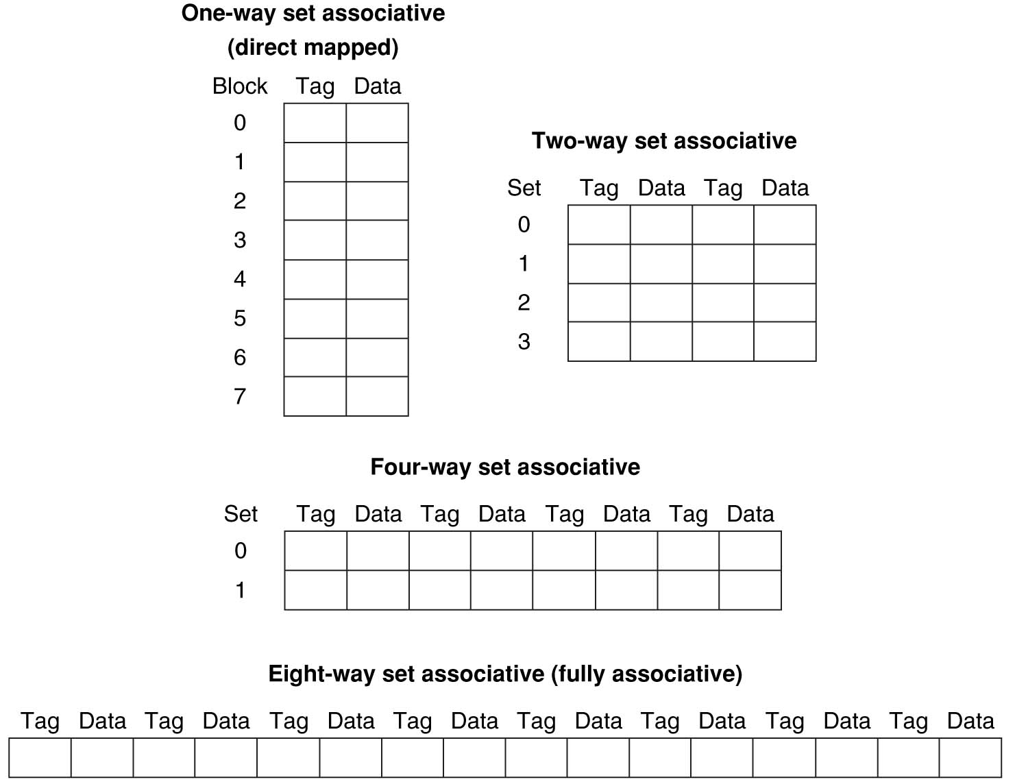
Example: Eight-Block Cache with Different Organizations
Total size of $ in blocks is equal to number of sets x associativity. For fixed $ size, increasing associativity decreases number of sets while increasing number of elements per set. With eight blocks, an 8-way set-associative $ is same as a fully associative $.

Slide 57
Recall: Direct Mapped Cache Layout Example 2
32 bit address space. Tag: 20 bits; Index: 8 bits; Offset: 4 bits
16 Bytes/block, cache size = 2⁸=256 blocks * 16 Bytes/block = 4K Bytes (1K words)
2^20=1 million memory addresses mapped to each cache index (blue line)
Byte offset
Hit
31 30 . . . 13 12 11 . . . 4 3 2 1 0
Data
Tag
20
8
Block offset
Index
Index
Valid
Tag
Data (words)
0
1
2
.
.
.
253
254
255
20
and
32
Notes:
to take advantage for spatial locality want a cache block that is larger than word word in size.

Slide 58
Four-Way Set-Associative Cache
32 bit address space. Tag: 22 bits; Index: 8 bits; Offset: 2 bits
4 Bytes/block, cache size = 4 Ways * 2⁸=256 blocks/way * 4 Bytes/block = 4K Bytes (1K words)
2^22=4 million memory addresses mapped to each cache set index (blue line)
31 30 . . . 13 12 11 . . . 2 1 0
Byte offset
Tag
22
8
Index
Index
V
Tag
Data
V
Tag
Data
V
Tag
Data
V
Tag
Data
0
1
2
.
.
.
253
254
255
0
1
2
.
.
.
253
254
255
0
1
2
.
.
.
253
254
255
0
1
2
.
.
.
253
254
255
Way 0
Way 1
Way 2
Way 3
32
4x1 select
Hit
Data
Notes:
2⁸ = 256 sets each with four ways (each with one block)
This is called a 4-way set associative cache because there are four cache entries for each cache index. Essentially, you have four direct mapped cache working in parallel.
This is how it works: the cache index selects a set from the cache. The four tags in the set are compared in parallel with the upper bits of the memory address.
If no tags match the incoming address tag, we have a cache miss.
Otherwise, we have a cache hit and we will select the data from the way where the tag matches occur.
This is simple enough. What is its disadvantages?
+1 = 36 min. (Y:16)

Slide 59
Explanations
This is called a 4-way set associative cache because there are 4 cache entries for each cache index. Essentially, you have four direct mapped cache working in parallel.
The cache index selects a set from the cache.
The four tags in the set are compared in parallel with the upper bits (Tag) of the memory address.
If no tags match the memory address tag, we have a cache miss.
Otherwise, we have a cache hit and we will select the data from the way where the tag matches occur.

Slide 60
Quiz
32 bit address space, 32KB 4-way set associative cache with 8 word blocks. What is the TIO breakdown?
1 | T - 21 I - 8 O - 3
2 | T - 19 I - 10 O - 3
3 | T - 17 I - 12 O - 3
4 | T - 19 I - 8 O - 5
5 | T - 17 I - 10 O - 5
6 | T - 15 I - 12 O - 5

Slide 61
Quzz Answer
32 bit address space, 32KB 4-way set associative cache with 8-word blocks. What is the TIO breakdown?
8 word blocks => 32 bytes / block => O = 5
32 KB / (32 bytes / block) = 2^10 blocks total
2^10 blocks / (4 blocks / set) = 2^8 sets total
Index bits will index into sets => I = 8
1 | T - 21 I - 8 O - 3
2 | T - 19 I - 10 O - 3
3 | T - 17 I - 12 O - 3
4 | T - 19 I - 8 O - 5
5 | T - 17 I - 10 O - 5
6 | T - 15 I - 12 O - 5

Slide 62
Quiz Answer Cont’
32 bit address space, 32KB direct-mapped cache with 8-word blocks.
T - 17, I - 10, O – 5
32 bit address space, 32KB fully-associative cache with 8-word blocks.
T - 27, I - 0, O – 5
For a direct-mapped cache, when do you have 0 Tag bits?
When the cache size is equal to memory size, which is obviously unrealistic. Hence you always have tag bits!

Slide 63
Range of Set-Associative Caches
For a fixed-size cache, each increase by a factor of two in associativity doubles the number of blocks per set (i.e., the number or ways) and halves the number of sets – decreases the size of the index by 1 bit and increases the size of the tag by 1 bit
Used for tag compare
Selects the set
Selects the word in the block
Tag
Index
Block offset
Byte offset
Increasing associativity
Decreasing associativity
Fully associative
(only one set)
Tag is all the bits except
block and byte offset
Direct mapped
(only one way)
Smaller tags, only a single comparator
Notes:
For lecture
In 2008, the greater size and power consumption of CAMs generally leads to 2-way and 4-way set associativity being built from standard SRAMs with comparators with 8-way and above being built using CAMs
Example: moving from 20-bit Tag,

Slide 64
Costs of Set-Associative Caches
N-way set-associative cache costs
A N-way SA cache will need N parallel comparators for tag comparisons instead of just one comparator for DM cache
It is slower than a DM cache because of this extra multiplexer delay. → Hit time is larger.
Notes:
Must choose appropriate set (multiplexer) before data is available
First of all, a N-way set associative cache will need N comparators instead of just one comparator (use the right side of the diagram for direct mapped cache).
A N-way set associative cache will also be slower than a direct mapped cache because of this extra multiplexer delay.
Finally, for a N-way set associative cache, the data will be available AFTER the hit/miss signal becomes valid because the hit/mis is needed to control the data MUX.
For a direct mapped cache, that is everything before the MUX on the right or left side, the cache block will be available BEFORE the hit/miss signal (AND gate output) because the data does not have to go through the comparator.
This can be an important consideration because the processor can now go ahead and use the data without knowing if it is a Hit or Miss. Just assume it is a hit.
Since cache hit rate is in the upper 90% range, you will be ahead of the game 90% of the time and for those 10% of the time that you are wrong, just make sure you can recover.
You cannot play this speculation game with a N-way set-associative cache because as I said earlier, the data will not be available to you until the hit/miss signal is valid.
+2 = 38 min. (Y:18)

Slide 65
Cache Block Replacement Policies
Random Replacement
Hardware randomly selects a cache block and throws it out
Least Recently Used
Hardware keeps track of access history
Replace the block that has not been used for the longest time
Notes:
When miss occurs, which way’s block selected for replacement?
Least Recently Used (LRU): one that has been unused the longest
Must track when each way’s block was used relative to other blocks in the set
For 2-way SA $, one bit per set → set to 1 when a block is referenced; reset the other way’s bit (i.e., “last used”)
Example of a Simple “Pseudo” LRU Implementation
Assume 64 Fully Associative entries in a set.
Hardware replacement pointer points to one cache entry
Whenever access is made to the entry the pointer points to:
Move the pointer to the next entry
Otherwise: do not move the pointer

Slide 66
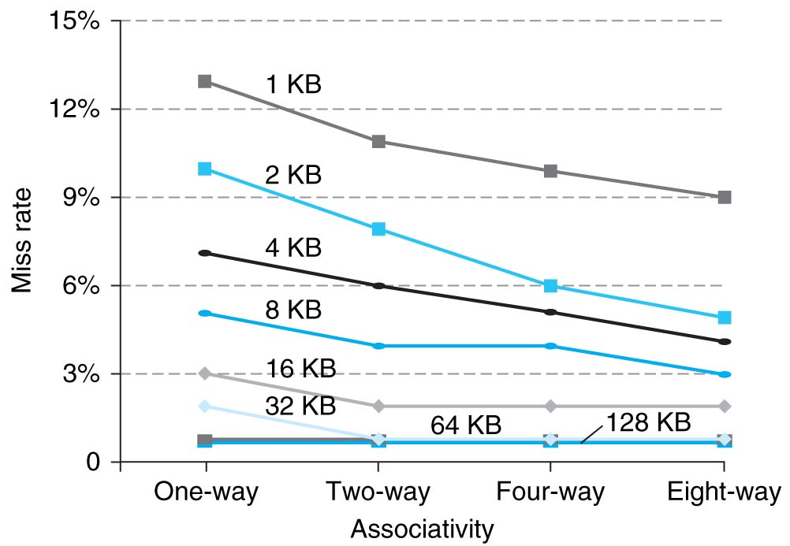
Benefits of Set-Associative Caches
Choice of DM $ or SA $ depends on the cost of a miss versus the cost of implementation
Largest gains are in going from direct mapped to 2-way (20%+ reduction in miss rate)
Notes:
As cache sizes grow, the relative improvement from associativity increases only slightly; since the overall miss rate of a larger cache is lower, the opportunity for improving the miss rate decreases and the absolute improvement in miss rate from associativity shrinks significantly.

Slide 67
How to Calculate 3C’s using Cache Simulator
Compulsory: set cache size to infinity and fully associative, and count number of misses
Capacity: Change cache size from infinity, usually in powers of 2, and count misses for each reduction in size
16 MB, 8 MB, 4 MB, … 128 KB, 64 KB, 16 KB
Conflict: Change from fully associative to n-way set associative while counting misses
Fully associative, 16-way, 8-way, 4-way, 2-way, 1-way

Slide 68
Improving Cache Performance: Summary
1. Reduce the time to hit in the cache
Smaller cache
1 word blocks (no multiplexor/selector to pick word)
2. Reduce the miss rate
Bigger cache
Larger blocks (16 to 64 bytes typical)
More flexible placement by increasing associativity

Slide 69
Improving Cache Performance: Summary
3. Reduce the miss penalty
Smaller blocks
Use multiple cache levels
L2 cache not tied to processor clock rate
Write-back instead of write-through:
Use a write buffer to hold dirty blocks being replaced so don’t have to wait for the write to complete before reading. Check write buffer on read miss – may get lucky
Faster backing store/improved memory bandwidth

Slide 70
The Cache Design Space
Several interacting dimensions
Cache size
Block size
Associativity
Write-through vs. write-back
Write-allocate vs write-no-allocate
Replacement policy (for associative cache)
Optimal choice is a compromise
Depends on access characteristics
Workload
Use (I-cache, D-cache)
Depends on technology / cost
Simplicity often wins
Cache Size
(Associativity)
Block Size
Bad
Good
Factor A
Factor B
Less
More
Notes:
No fancy replacement policy is needed for the direct mapped cache.
As a matter of fact, that is what cause direct mapped trouble to begin with: only one place to go in the cache--causes conflict misses.
No fancy replacement policy is needed for the direct mapped cache.
As a matter of fact, that is what cause direct mapped trouble to begin with: only one place to go in the cache--causes conflict misses.
Besides working at Sun, I also teach people how to fly whenever I have time.
Statistic have shown that if a pilot crashed after an engine failure, he or she is more likely to get killed in a multi-engine light airplane than a single engine airplane.
The joke among us flight instructors is that: sure, when the engine quit in a single engine stops, you have one option: sooner or later, you land. Probably sooner.
But in a multi-engine airplane with one engine stops, you have a lot of options. It is the need to make a decision that kills those people.

Slide 71
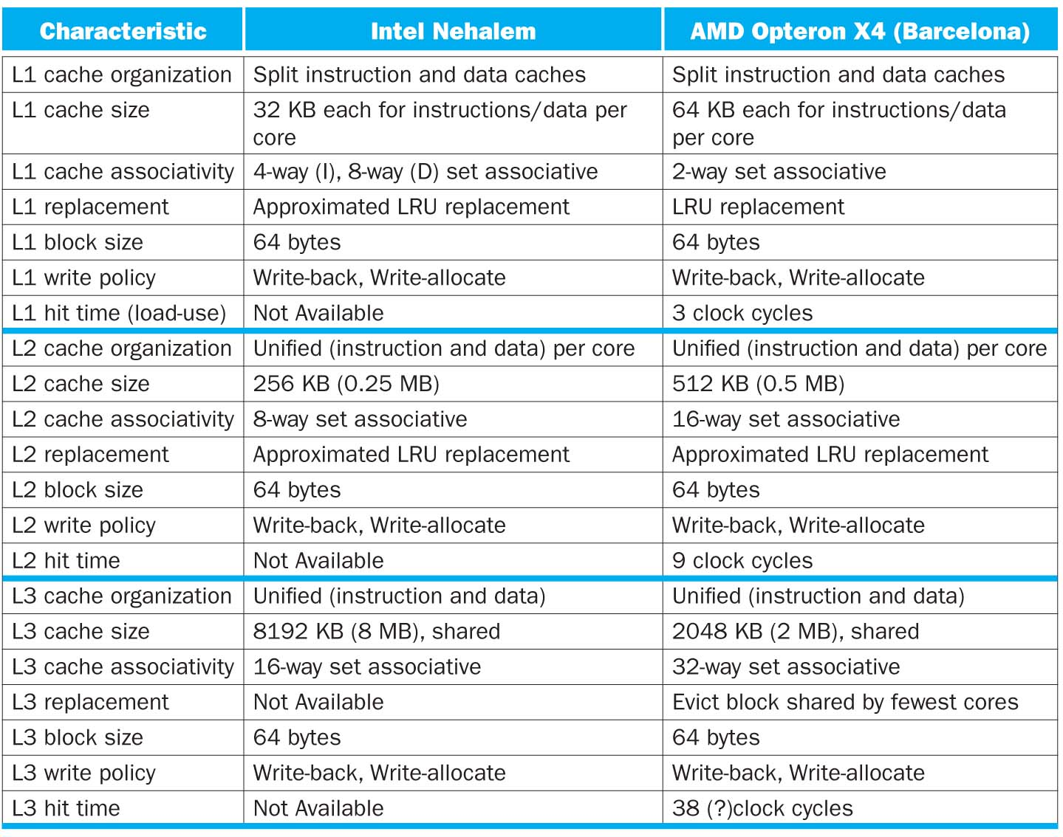
L1→L2→L3
Size increasing
Associativity increasing
Both cause hit time to increase, and miss rate to decrease

Slide 72
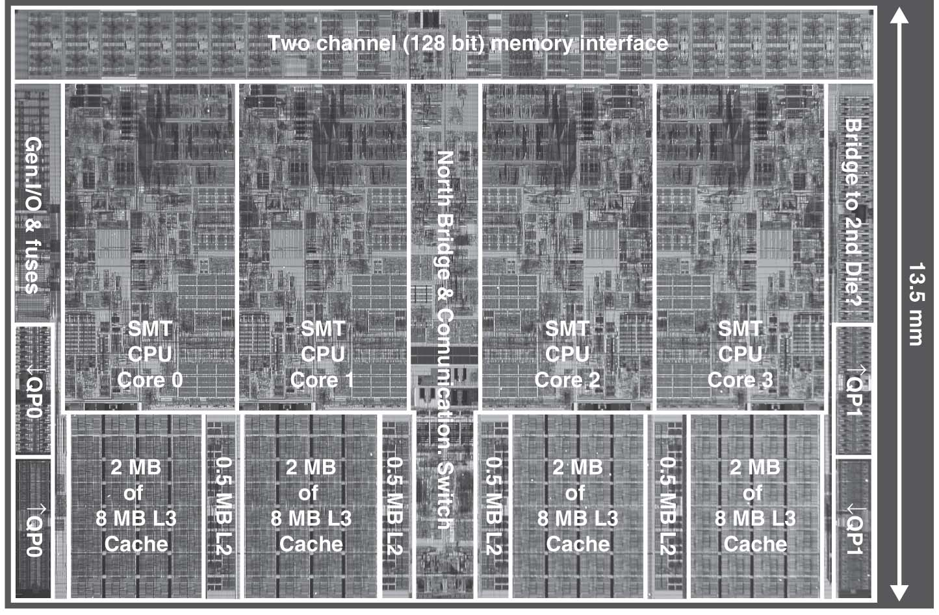
Intel Nehalem Die Photo
4 cores, 32KB I$/32-KB D$ L1$, 512KB L2$. L1$ and L2$ are private to each core
Share one single 8-MB L3$

Slide 73
Keeping Multiple Caches Coherent
HW Architect’s job: shared memory => keep cache values coherent
One approach: When any processor has cache miss or writes, notify other processors via interconnection network
If only reading, many processors can have copies
If a processor writes, invalidate all other copies, and write through to memory
Shared written result can “ping-pong” between caches

Slide 74
Shared Memory and Caches
What if?
Processors 1 and 2 read Memory[1000] (value 20)
P0
P1
P2
Cache
1000 20
1000 20
Cache
Cache
Interconnection Network
Memory
20
I/O

Slide 75
Shared Memory and Caches
What if?
Processors 1 and 2 read Memory[1000]
Processor 0 writes Memory[1000] with 40
0
Processor 0
Write
Invalidates
Other Copies
Processor
1
2
1000
Processor
Processor
1000 40
1000 20
1000 20
Cache
Cache
Cache
Interconnection Network
1000 40
Memory
I/O

Slide 76
False Sharing
Suppose block size is 32 bytes
Suppose Processor 0 reading and writing variable X, Processor 1 reading and writing variable Y
Suppose X is at address 4000, Y in 4012
Two variables are in the same cache block, even though they have different addresses
Effect called false sharing
Notes:
How can you prevent it?

Slide 77
Summary #1/2: Cache
The Principle of Locality:
Program likely to access a relatively small portion of the address space at any instant of time.
Temporal Locality: Locality in Time
Spatial Locality: Locality in Space
Three Major Categories of Cache Misses:
Compulsory Misses: sad facts of life. Example: cold start misses.
Conflict Misses: increase cache size and/or associativity
Capacity Misses: increase cache size
Notes:
Let’s summarize today’s lecture. I know you have heard this many times and many ways but it is still worth repeating.
Memory hierarchy works because of the Principle of Locality which says a program will access a relatively small portion of the address space at any instant of time.
There are two types of locality: temporal locality, or locality in time and spatial locality, or locality in space.
So far, we have covered three major categories of cache misses.
Compulsory misses are cache misses due to cold start. You cannot avoid them but if you are going to run billions of instructions anyway, compulsory misses usually don’t bother you.
Conflict misses are misses caused by multiple memory location being mapped to the same cache location.
The nightmare scenario is the ping pong effect when a block is read into the cache but before we have a chance to use it, it was immediately forced out by another conflict miss.
You can reduce Conflict misses by either increase the cache size or increase the associativity, or both.
Finally, Capacity misses occurs when the cache is not big enough to contains all the cache blocks required by the program. You can reduce this miss rate by making the cache larger.
There are two write policy as far as cache write is concerned. Write through requires a write buffer and a nightmare scenario is when the store occurs so frequent that you saturates your write buffer.
The second write polity is write back. In this case, you only write to the cache and only when the cache block is being replaced do you write the cache block back to memory.
+3 = 77 min. (Y:57)

Slide 78
Summary #1/2: Cache
Cache Organizations:
Direct Mapped: single block per set
Set associative: more than one block per set
Fully associative: all entries equivalent
Set-associativity - Reduce Cache Miss Rate
Memory block maps into more than 1 cache block
N-way: N possible places in cache to hold a memory block
Multi-level caches - Reduce Cache Miss Penalty
Optimize first level to be fast!
Optimize 2nd and 3rd levels to minimize the memory access penalty
Lots of cache parameters!
Write-back vs. write through, write-allocate, block size, cache size, associativity, etc.

Slide 79
Quiz I
Q: Consider 32-bit address space; a direct-mapped cache with size 16KB;each cache block is 4 words. What is the TIO breakdown?
A:
Cache size = 16KB = 16 * 2^10 bytes
Cache block size = 4 words = 4 * 4 bytes = 16 bytes = 2^4
Number of cache blocks= 16 * 2^10 bytes / 16 bytes = 2^10
Index bits = 10
Offset bits = 4
Tag bits = 32 – 10 – 4 = 18

Slide 80
Quiz II
Q: Consider 32-bit address space; a two-way set-associative cache with size 16KB;each cache block is 4 words. What is the TIO breakdown?
A:
Cache size = 16 * 2^10 bytes
cache block size = 16 bytes
Set size = cache block size * set associativity = 16 bytes * 2 = 32 bytes
Number of sets = 16 * 2^10 bytes / 32 bytes = 2^9
Index bits = 9
Offset bits = 4
Tag bits = 32 – 9 – 4 = 19

Slide 81
Quiz III
Q: How many 32-bit integers can be stored in a byte-addressed direct-mapped cache with 15 tag bits, 15 index bits, and 2 offset bits?
A: Each cache block is 2^2=4 Bytes and can store one 32-bit integer. The cache has a total number of 2^15=32K blocks, hence it can store 32K integers.
Notes:
Q: You are trying to access memory byte address 0x3434 in a system with a 16 bit address space. What are the corresponding tag, index and offset for a 32-line direct-mapped cache with 1 word blocks? (in hex)
A: The cache has TIO breakdown of 9:5:2 (1 word = 4 Bytes → 2 Offset Bits; 32-line cache → 5 Index Bits; 16-(5+2)=9 Tag Bits.) Memory address 0x3434 in binary is 0011010000110100 (Online hex converter: Online hex converter: http://easycalculation.com/hex-converter.php)
You are trying to access memory byte address 0x3434 in a system with a 16 bit address space. What are the corresponding tag, index and offset for a 16-line direct-mapped cache with 4 word blocks? (in hex)
You are trying to access memory byte address 0x3434 in a system with a 16 bit address space. What are the corresponding tag, index and offset for a 1kiB direct-mapped cache with 2 word blocks? (in hex)
What is the ratio of data bits to total bits in a 128 byte write-back direct-mapped cache that has 2-word blocks and is part of a 64-bit byte-addressed memory system?

Slide 82
Quiz IV
Consider 8-bit address space; a direct mapped, write-back, write-allocate cache that can hold two blocks of 8 Bytes each. The cache is initially empty. The following sequence of memory operations are made, where each reference is a byte address of a 4-byte number (Only consider word aligned word addresses, i.e. locations 0, 4, 8, and so on. lw: load word; sw: store word) :
lw 0
sw 44
lw 52
lw 88
lw 0
sw 52
lw 68
lw 44
Work out the cache behavior after each operation.

Slide 83
Quiz IV Answer
Tag: 4 Index: 1 Offset: 3. The low-order 3 bits of an address specifies the byte address, and the next 1 bit is the index. I'll write addresses as a triple of tag:index:offset. We have:
lw 0 = 0000:0:000
Bytes 0-7 loaded into cache index 0.
sw 44= 0010:1:100
Bytes 40-47 loaded into cache index 1; bytes 44-47 modified; block marked "dirty".
lw 52 = 0011:0:100
Bytes 48-55 loaded into cache index 0; Clean miss (since replaced block was clean), previous block discarded
lw 88 = 0101:1:000
Bytes 88-95 loaded into cache index 1; Dirty miss (since replaced block was dirty); previous (dirty) contents written back to memory; block marked "clean“
lw 0 = 0000:0:000
Bytes 0-7 loaded into cache index 0. Clean miss; block marked “clean”
sw 52 = 0011:0:100
Bytes 48-55 loaded into cache index 0. Clean miss. bytes 52-55 modified; block marked "dirty".
lw 68 = 0010:0:100
Bytes 64-71 brought into cache index 0; Dirty miss; previous (dirty) contents written back to memory; block marked “clean”.
lw 44 = 0010:1:100
Bytes 40-47 loaded into cache index1; Clean miss; block marked "clean".

Slide 84
Quiz V
For a given cache size: a larger block size can cause a lower hit rate than a smaller one.
If you know your computer’s cache size, you can often make your code run faster.
Memory hierarchies take advantage of spatial locality by keeping the most recent data items closer to the processor.
ABC
1: FFF
1: FFT
2: FTF
2: FTT
3: TFF
3: TFT
4: TTF
5: TTT

Slide 85
Quiz V Answer
Yes – if the block size gets too big, fetches become more expensive and the big blocks force out more useful data.
Certainly! That’s call “tuning”
“Most Recent” items ⇒ Temporal locality
ABC
1: FFF
1: FFT
2: FTF
2: FTT
3: TFF
3: TFT
4: TTF
5: TTT

